Slide 1
BASIC ELECTRONICS
(24B11EC111)
Unit-1
Lecture-4
(Methods of DC Circuit Analysis)

Slide 2
CONTENTS
Methods of Analysis of Resistive Circuits
Node Voltage Method
Mesh Current Method
Node Voltage Analysis of Circuits with Current Sources
Node Voltage Analysis of Circuits with Current and Voltage Sources
Problem
References

Slide 3
Methods of Analysis of Resistive Circuits
Method for small circuits: write and solve a set of equations. Obtain equations using Kirchhoff’s current and voltage laws. The constitutive equations of the circuit elements, such as Ohm’s law, provide the remaining equations. The unknown variables are element currents and voltages.

Slide 4
Methods of Analysis of Resistive Circuits
For moderate-sized/Large-sized circuits, above method provides quite large set of equations.
So for such type of circuits, we consider two methods for writing a smaller set of simultaneous equations:
  The node voltage method.
  The mesh current method.

Slide 5
Node Voltage Method
The node voltage method uses a new type of variable called the node voltage.
The “node voltage equations” or, more simply, the “node equations,” are a set of simultaneous equations that represent a given electric circuit.
The unknown variables of the node voltage equations are the node voltages.
After solving the node voltage equations, we determine the values of the element currents and voltages from the values of the node voltages.

Slide 6
Node Voltage Method
It’s easier to write node voltage equations for some types of circuit than for others.
Starting with the easiest case, we will learn how to write node voltage equations for circuits that consist of:
  Resistors and independent current sources.
  Resistors and independent current and voltage sources.
  Resistors and independent and dependent voltage and current sources.

Slide 7
Mesh Current Method
The mesh current method uses a new type of variable called the mesh current.
The “mesh current equations” or, more simply, the “mesh equations,” are a set of simultaneous equations that represent a given electric circuit.
The unknown variables of the mesh current equations are the mesh currents.
After solving the mesh current equations, we determine the values of the element currents and voltages from the values of the mesh currents.

Slide 8
Mesh Current Method
It’s easier to write mesh current equations for some types of circuit than for others.
Starting with the easiest case, we will learn how to write mesh current equations for circuits that consist of:
  Resistors and independent voltage sources.
  Resistors and independent current and voltage sources.
  Resistors and independent and dependent voltage and current sources.

Slide 9
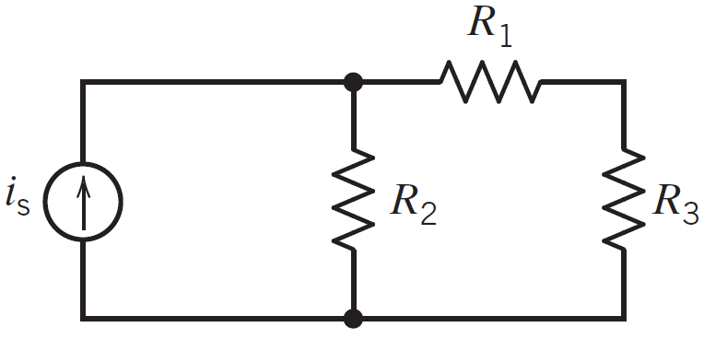
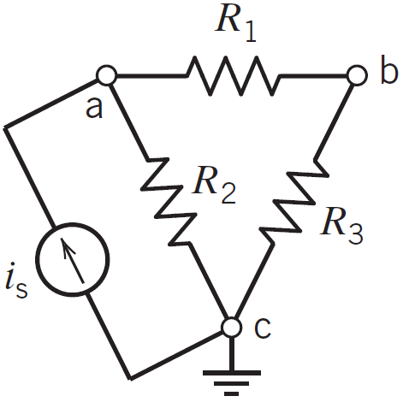
Node Voltage Analysis of Circuits with Current Sources
Consider the circuit shown in Figure.
This circuit contains four elements: three resistors and a current source.
Figure shows the same circuit, redrawn so that all three nodes are drawn as points rather than lines.
In Figure, the nodes are labeled as node a, node b, and node c.

Slide 10
Node Voltage Analysis of Circuits with Current Sources
Analyzing a connected circuit containing n nodes will require n - 1 KCL equations.
The node at which KCL is not applied is called the reference node.
Any node of the circuit can be selected to be the reference node.
We will often choose the node at the bottom of the circuit to be the reference node.
When the circuit contains a grounded power supply, the ground node of the power supply is usually selected as the reference node.
The voltage at any node of the circuit, relative to the reference node, is called a node voltage.

Slide 11
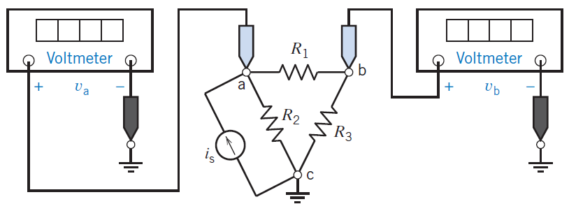
Node Voltage Analysis of Circuits with Current Sources
One of the standard methods for analyzing an electric circuit is to write and solve a set of simultaneous equations called the node equations.
The unknown variables in the node equations are the node voltages of the circuit.
We determine the values of the node voltages by solving the node equations.
To write a set of node equations, we do two things:
  Express element currents as functions of the node voltages.
  Apply Kirchhoff’s current law (KCL) at each of the nodes of the circuit except for the reference node.

Slide 12
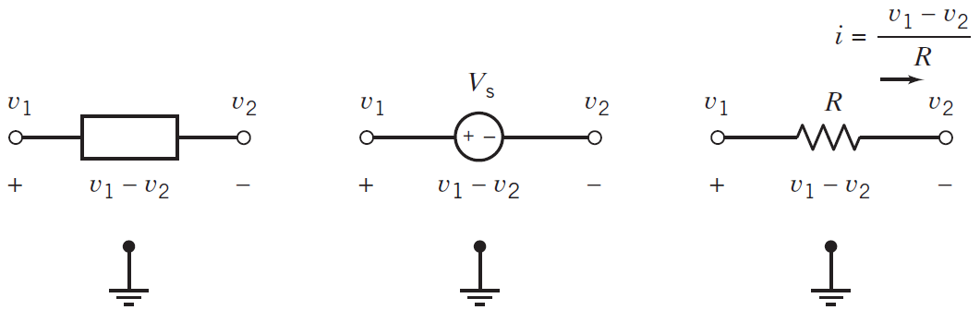
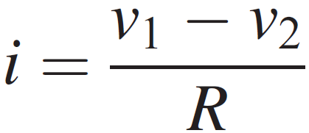
Node Voltage Analysis of Circuits with Current Sources
The circuit element in Figure could be anything: a resistor, a current source, a dependent voltage source, and so on.
In Figure , the circuit element is a resistor. We will use Ohm’s law to express the resistor current i as a function of the node voltages.

Slide 13
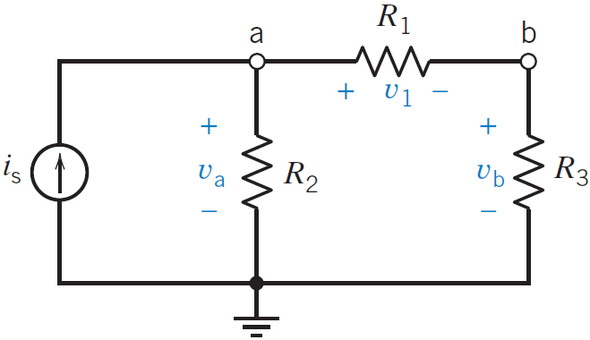
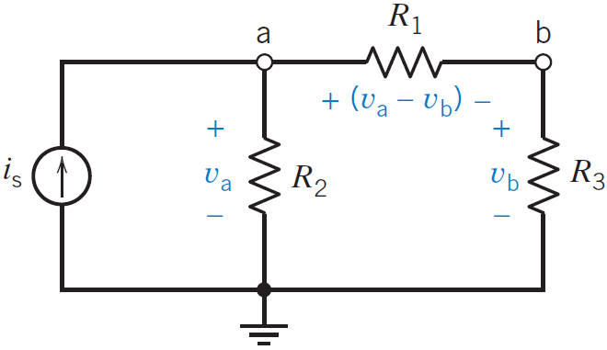
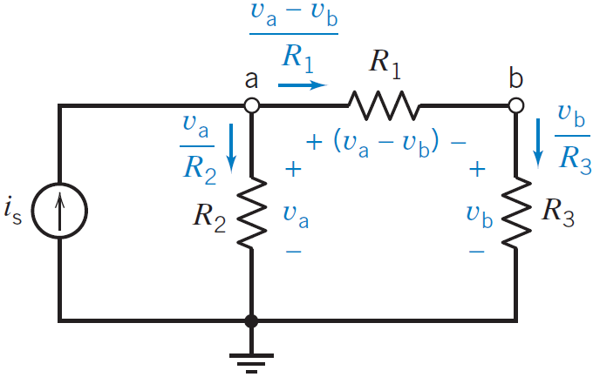
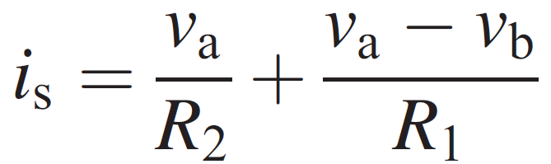
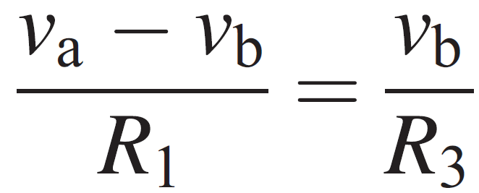
Node Voltage Analysis of Circuits with Current Sources
let’s write node equations to represent the circuit shown in Figure.
The input to this circuit is the current source, current i_{s}.
To write node equations, we will first express the resistor currents as functions of the node voltages and then apply Kirchhoff’s current law at nodes a and b.
Using KCL at node a gives
the KCL equation at node b is

Slide 14
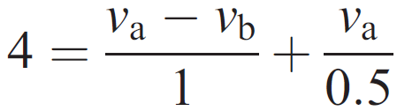
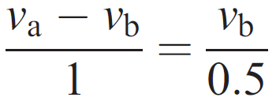
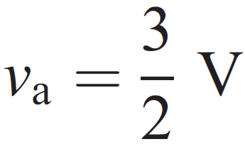
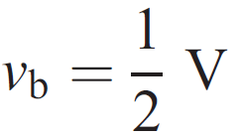
Node Voltage Analysis of Circuits with Current Sources
Using KCL at node a gives
the KCL equation at node b is
On solving the equations, the node voltages of this circuit are

Slide 15
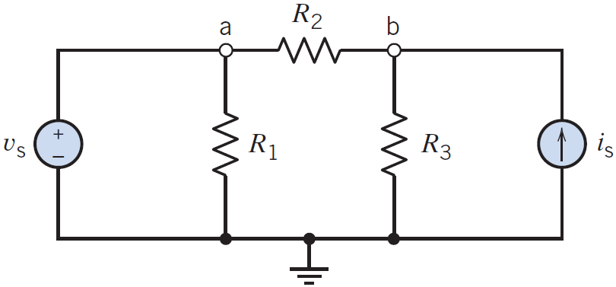
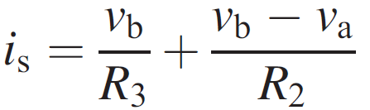
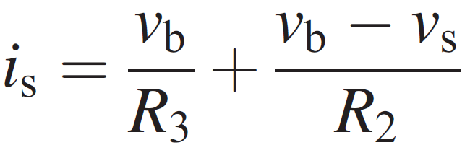
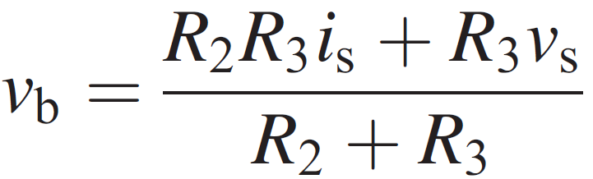
Node Voltage Analysis of Circuits with Current and Voltage Sources
First we consider the circuit with a voltage source between ground and one of the other nodes.
Because we are free to select the reference node, this particular arrangement is easily achieved.
We immediately note that the source is connected between terminal a and ground and, therefore,
v_{a} = v_{s}
KCL equation at node b

Slide 16
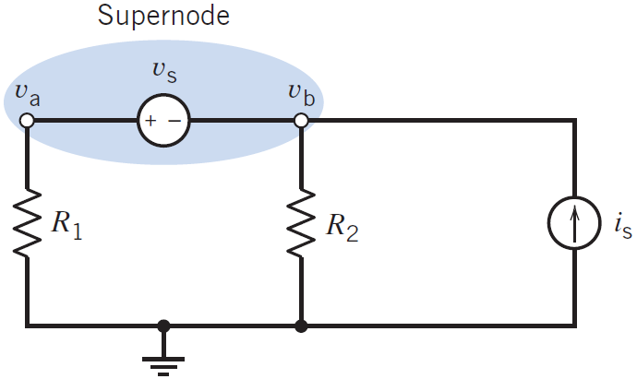
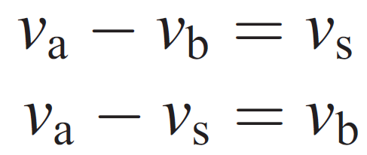
Node Voltage Analysis of Circuits with Current and Voltage Sources
consider the circuit of Figure, which includes a voltage source between two nodes.
Because the source voltage is known, use KVL to obtain
To account for the fact that the source voltage is known, we consider both node a and node b as part of one larger node represented by the shaded ellipse.
This larger node is often called a supernode or a generalized node.
KCL says that the algebraic sum of the currents entering a supernode is zero.
That means that we apply KCL to a supernode in the same way that we apply KCL to a node.

Slide 17
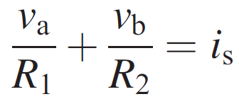
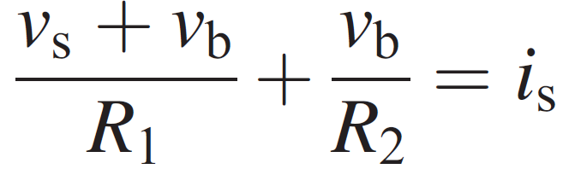
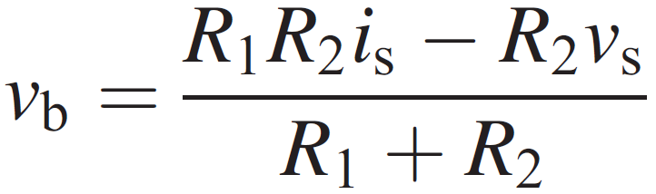
Node Voltage Analysis of Circuits with Current and Voltage Sources
A supernode consists of two nodes connected by an independent or a dependent voltage source
KCL equation at the supernode as

Slide 18
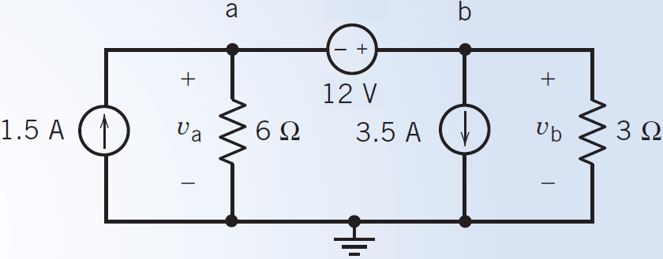

Problem
Determine the values of the node voltages v_{a} and v_{b} for the circuit shown in Figure
We can write the first node equation by considering the voltage source.

Slide 19
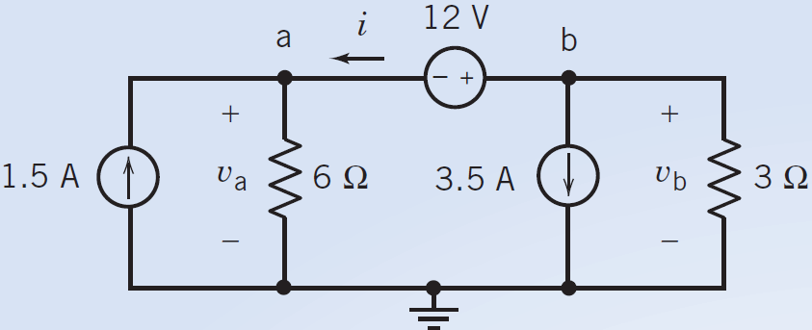
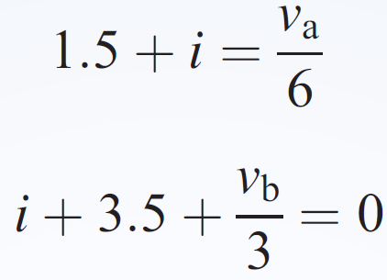
Problem - Solution
To write the second node equation, we must decide what to do about the voltage source current. (Notice that there is no easy way to express the voltage source current in terms of the node voltages.)
In this example, we illustrate two methods of writing the second node equation.
Assign a name to the voltage source current. Apply KCL at both of the voltage source nodes. Eliminate the voltage source current from the KCL equations.
Method 1:
The KCL equation at node a is
The KCL equation at node b is

Slide 20
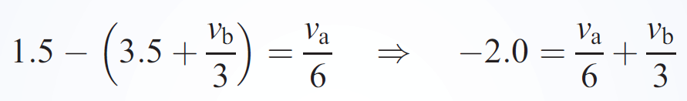
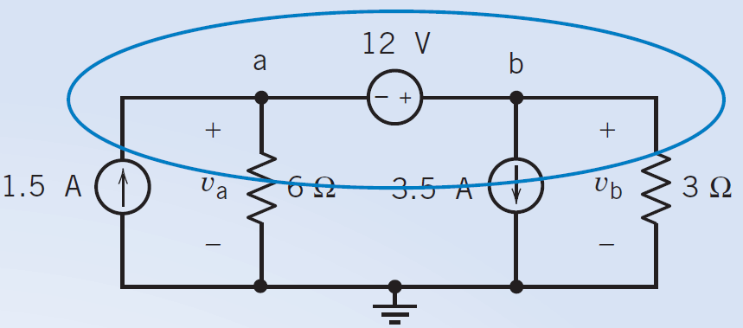
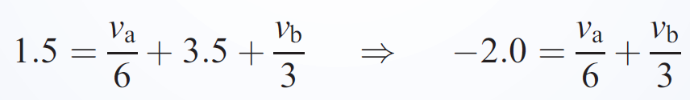
Problem - Solution
Combining these two equations gives
Method 2:
Apply KCL to the supernode to get

Slide 21
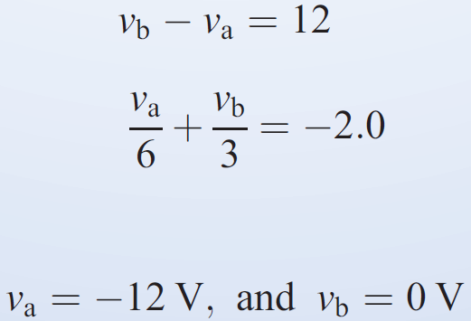
Problem - Solution
This is the same equation that was obtained using method 1. Applying KCL to the supernode is a shortcut for doings three things:
  Labeling the voltage source current as i.
  Applying KCL at both nodes of the voltage source.
  Eliminating i from the KCL equations.

Slide 22
References
R.C. Dorf and James A. Svoboda, “Introduction to Electric Circuits”, 9th ed, John Wiley & Sons, 2013.
D.C. Kulshreshtha, Basic Electrical Engineering, Revised 1st ed, Tata Mc Graw Hill, 2017.
V. K.Mehta, Rohit Mehta, Basic Electrical Engineering, 6th ed, S. Chand Publishing, 2012.

